Slide 1

CSIS-4260 Special Topic in Data Analytics
Apple’s Stocks Price Prediction
Thaw, May Pyae Phyo
Student ID -300367691

Slide 2
Table of content
# | Descriptions
1. | Project Introduction (Industry & Market Background)
2. | Data Collections & Processing
3. | Stocks Data Analysis
5. | Stock Price prediction with Machine Learning(APPLE INC)
6. | Algorithm and Model Training
7. | Insight of Model Performances
8. | Conclusion
9. | References & Links

Slide 3



Project Introduction (Industry & Market Background)

Slide 4
WHY APPLE INC STOCK?
To understand market context before modeling Apple’s stock
Stock prices don’t exist in a vacuum — they move with the market. By identifying high-performing sectors and leading companies, we get insight into the economic environment influencing Apple.
To validate Apple’s sector (Technology) performance over time
Before jumping into prediction, we confirmed that Technology has been one of the top-performing sectors over the last 5 years — making Apple a strong candidate for analysis.
To identify comparable companies and benchmark opportunities
By looking at top companies within Technology, we can compare Apple against peers like Microsoft or Nvidia — helping us understand whether Apple is leading, lagging, or in line.
Over the past 5 years, there are 3 industries with highest of Returns which are
Energy – 344 %
Technology – 201%
Financials – 176 %
Among those industries, NVIDIA & APPLE are closely competing each others.
Sources: Yahoo Finance (yfinance), FMP API | Code: industry_analysis.py, top_3_companiesofsectors.py

Slide 5

Data Collections & Processing

Slide 6




How are Data collected and Processed?
5 years news data are scrapped by using 3 different places.
Sources | Total
NewsAPI | 840
Google RSS | 4454
Google Custom | 1039
Yahoo Finance | 10
News Data
5 years stock historic data of Apple are extracted from Yfinance library.
Stock Data
Sources: Yahoo Finance (yfinance), FMP API, Google News RSS, Google Custom Search (BS4), NewsAPI.org, Yahoo Finance News (yfinance) | Code: industry_analysis.py, top_3_companiesofsectors.py, 4.A_D_AppleNews_GoogleRSS.py, 4.B_AppleNews_Scrape_NewsAPI.py, 4.C_AppleNews_Scrape_Yfinance.py, 5.D_News_MergeNClean_extracted_files.py_

Slide 7

How are Data collected and Processed?
Most of the news from Google RSS are only with headlines and keywords.
Sources | Total
NewsAPI | 840
Google RSS | 4454
Google Custom | 1039
Yahoo Finance | 10
Total | 6343
Used OpenAI to generate Summary of Google news and added the following for News data
GPT Summary
GPT Sentiment_Score
GPT Positive_Score
GPT Negative_Score
GPT Important_Score
GPT Direction
GPT_Event_Type
GPT_relevance_to_apple
Stocks data are added with Technical Indicators such as
Simple Moving Average, Exponential Moving Average
Relative Strength Index, Bollinger Bands
Average True Range, Average Directional Index
Moving Average Convergence Divergence
Sources: apple_stock_with_indicators.csv, apple_stock_news_with_summary.csv, apple_stock_enriched_phase2_output.csv | OpenAI | Code: 3.Apple_5yr_historicdata.py 5.A_Preprocessing.py, 5.C_Get_Apple_Simplified.py, 5.E_Generate_Summary.py

Slide 8

Stocks Data Analysis

Slide 9
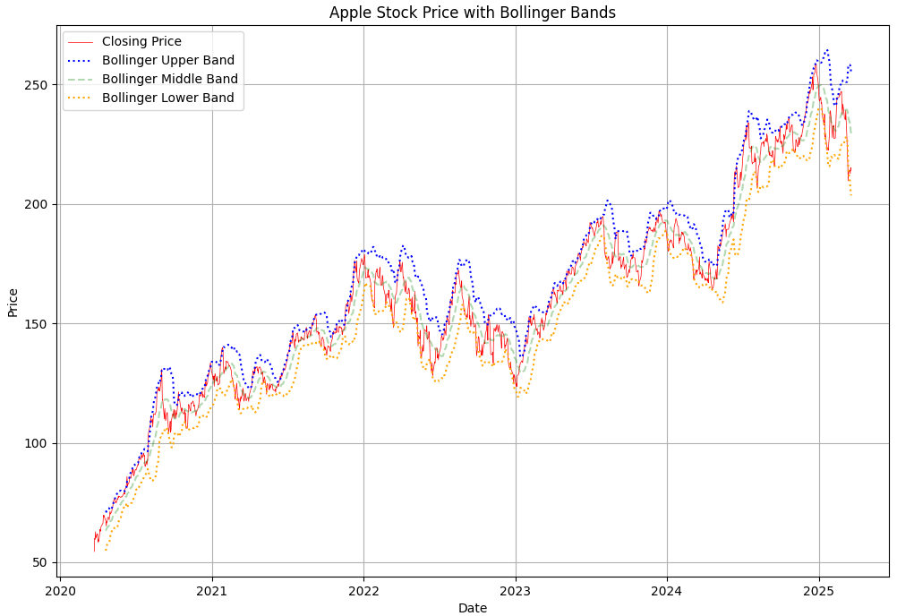
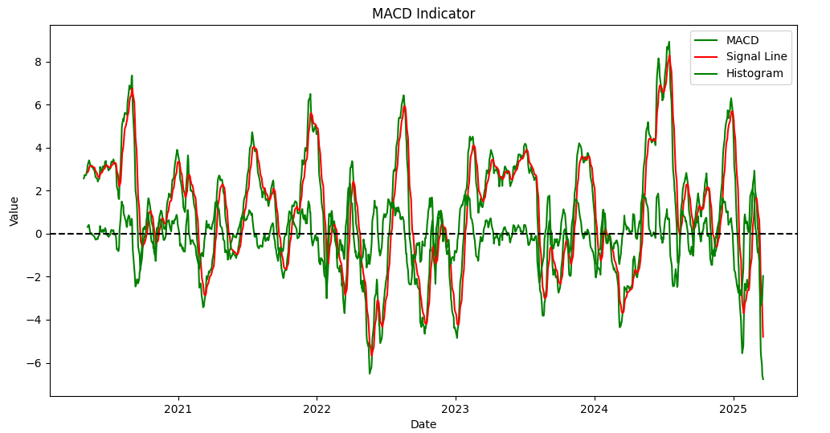
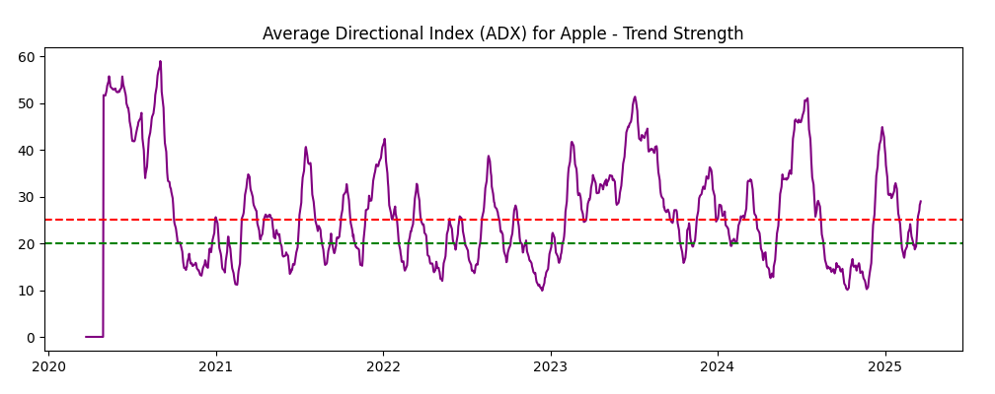
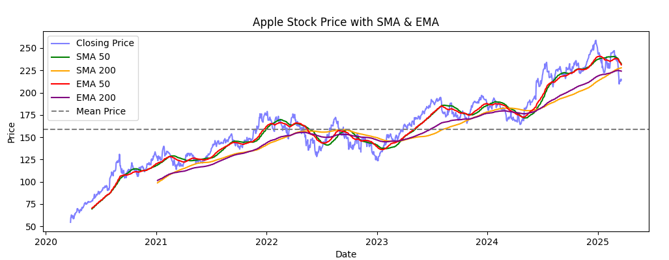
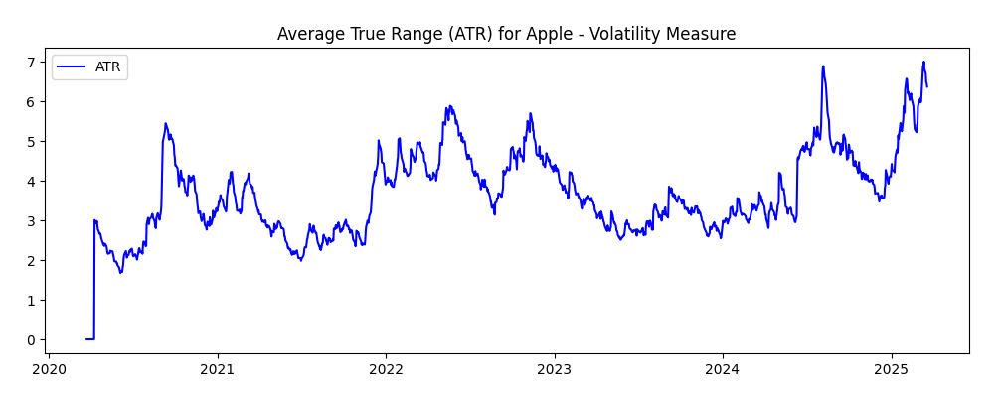
Technical Indicators Data Evaluation
Sources: apple_stock_with_indicators.csv, apple_stock_news_with_summary.csv, apple_stock_enriched_phase2_output.csv | OpenAI | Code: 3.Apple_5yr_historicdata.py 5.A_Preprocessing.py, 5.C_Get_Apple_Simplified.py, 5.E_Generate_Summary.py

Slide 10
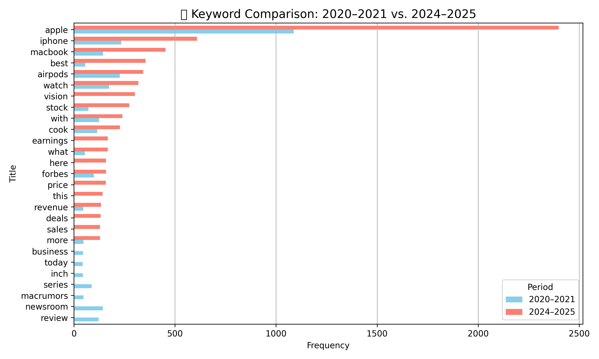
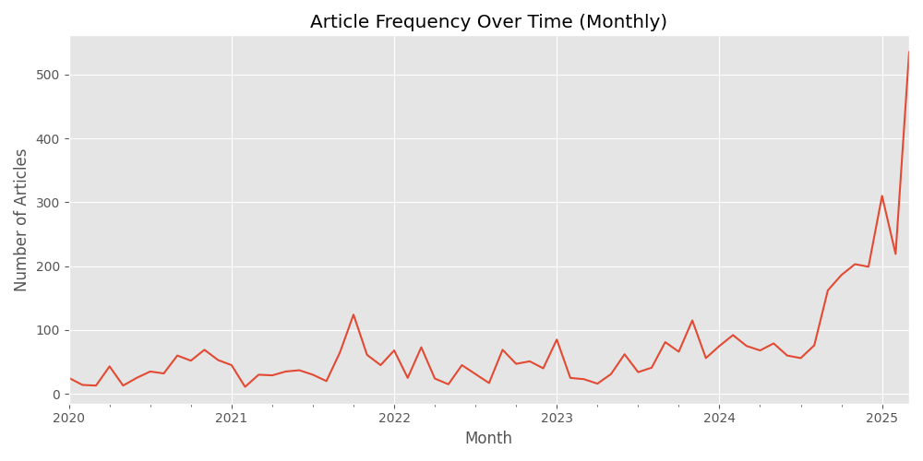
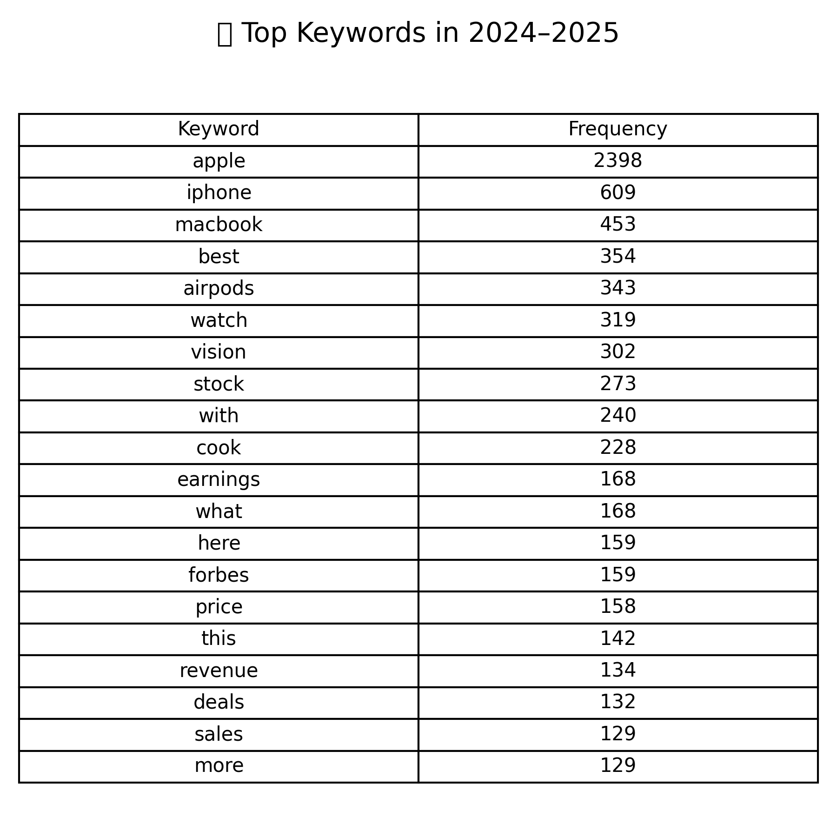
Articles Data Evaluation and Bertopic Modeling
Product mentions rose sharply in 2024–2025, with new interest in vision tech and earnings showing Apple’s evolving media narrative
Sources: apple_stock_with_indicators.csv, apple_stock_news_with_summary.csv, apple_stock_enriched_phase2_output.csv | OpenAI | Code: 5.B_Topic_Modeling_BERTopic.py
6.B_Keywords_Evaluation.py, 6.A_Overview_Summary.py, 6.C_Drop_in_Audit.py, 6.D_Audit_prt2.py, 6.D_Correlation_Analysis.py

Slide 11
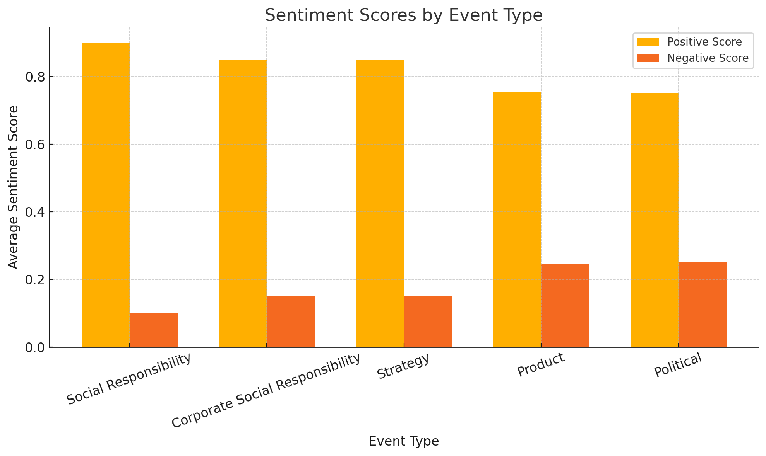
Con’t Articles Data Evaluation and Sentiment analysis
Average sentiment scores categorized by event type using GPT enrichment. While Product events dominate in volume, categories such as Social Responsibility and Strategy exhibit significantly higher positive sentiment with minimal negativity.
This highlights how different themes can influence market perception and potentially affect stock movement.
Sources: apple_stock_with_indicators.csv, apple_stock_news_with_summary.csv, apple_stock_enriched_phase2_output.csv | OpenAI | Code: 5.B_Topic_Modeling_BERTopic.py
6.B_Keywords_Evaluation.py, 6.A_Overview_Summary.py, 6.C_Drop_in_Audit.py, 6.D_Audit_prt2.py, 6.D_Correlation_Analysis.py

Slide 12

Stock Price prediction with Machine Learning(APPLE INC)
Model Evaluation using Technical + News-based Features

Slide 13
Libraries Used in Machine Learning
Core Libraries
Visualisation
Machine Learning
Utilisation
Pandas
Numpy
Matplotlib
Seaborn
sklearn.model_selection.train_test_split
sklearn.metrics
sklearn.preprocessing.StandardScaler, Polynomial Features
sklearn.pipeline.Pipeline,
sklearn.ensemble – RandomForestRegressor, GradientBoostingRegressor
sklearn.linear_model.Ridge
xgboost.XGBRegressor
scipy.stats.pearsonr – correlation sklearn.inspection.permutation_importance – feature importance
tabulate

Slide 14
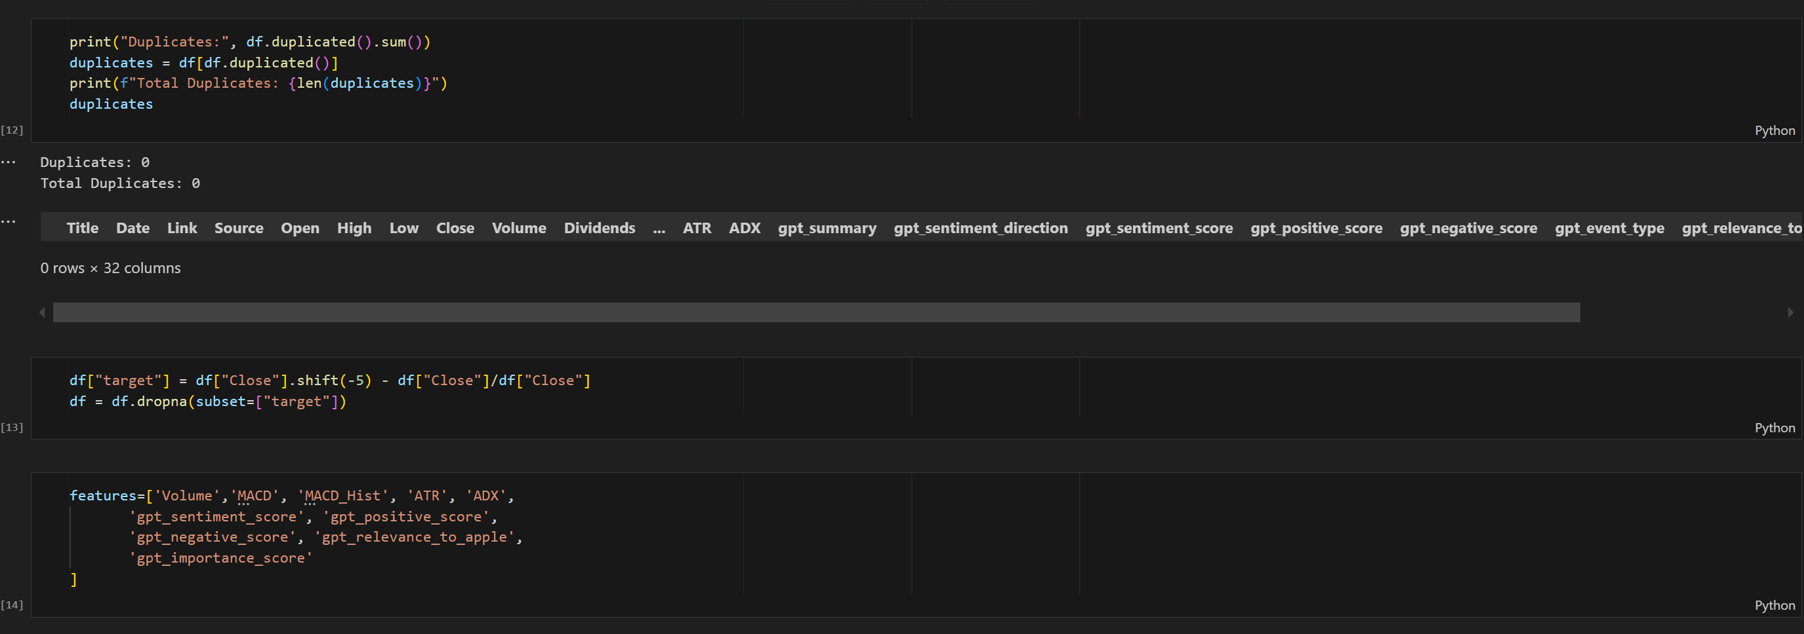
Processing of Data Before Training
Before this stage, pioneer stage of data cleansing, merging and nan data removal performed once already.

Slide 15
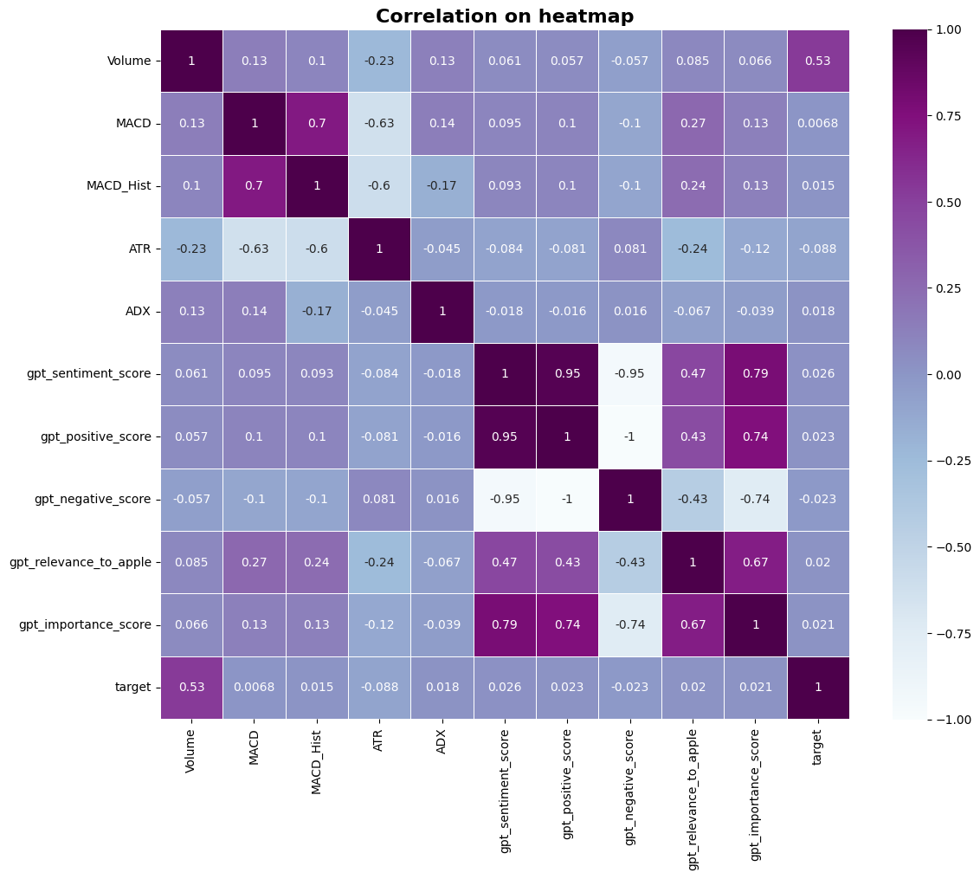
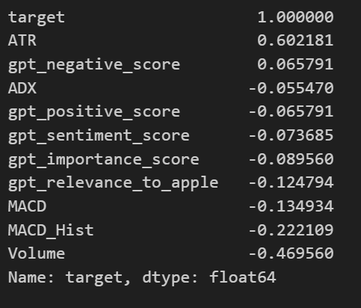
Correlation on Heatmap
High redundance data fields such as opening, high, low and correlation over 0.8 are considered to drop.

Slide 16
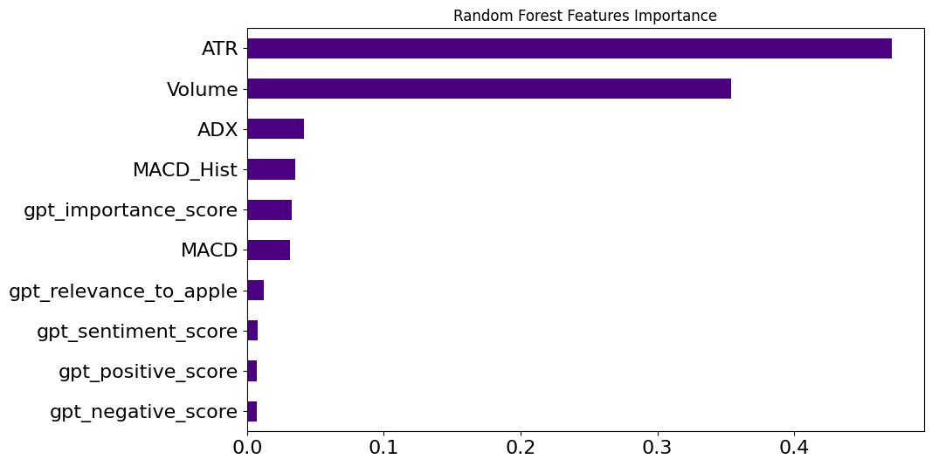
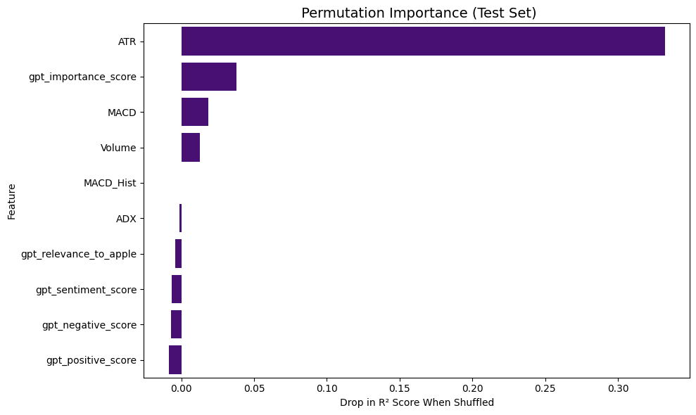
Feature Importance & Permutation Importance
ATR (Average True Range) and Volume are the two most dominant features, together accounting for the majority of the decision power.
Among GPT-enhanced news features, only gpt_importance_score has moderate relevance.
Indicators like MACD, ADX, and sentiment scores rank lower, suggesting the model prioritizes price volatility and trading activity.
ATR stands out again, causing the highest drop in R² score, confirming its critical role.
Interestingly, gpt_importance_score ranks second — suggesting that, while underutilized in the model's training logic, it contributes significantly to predictive accuracy on unseen data.
Other GPT-based features (e.g., sentiment_score, relevance_to_apple) show small but consistent influence.

Slide 17
Algorithm and Model Training
Model Evaluation using Technical + News-based Features

Slide 18


Target Variable & Model Performance Explanation
Target = Log-transformed 5-day forward price change
Formula: log(Closeₜ₊₅) − log(Closeₜ)
Captures both magnitude and direction of price change
Helps stabilize scale and reduce noise from high price volatility
Frequently used in financial modeling and easier for ML algorithms to learn

Slide 19
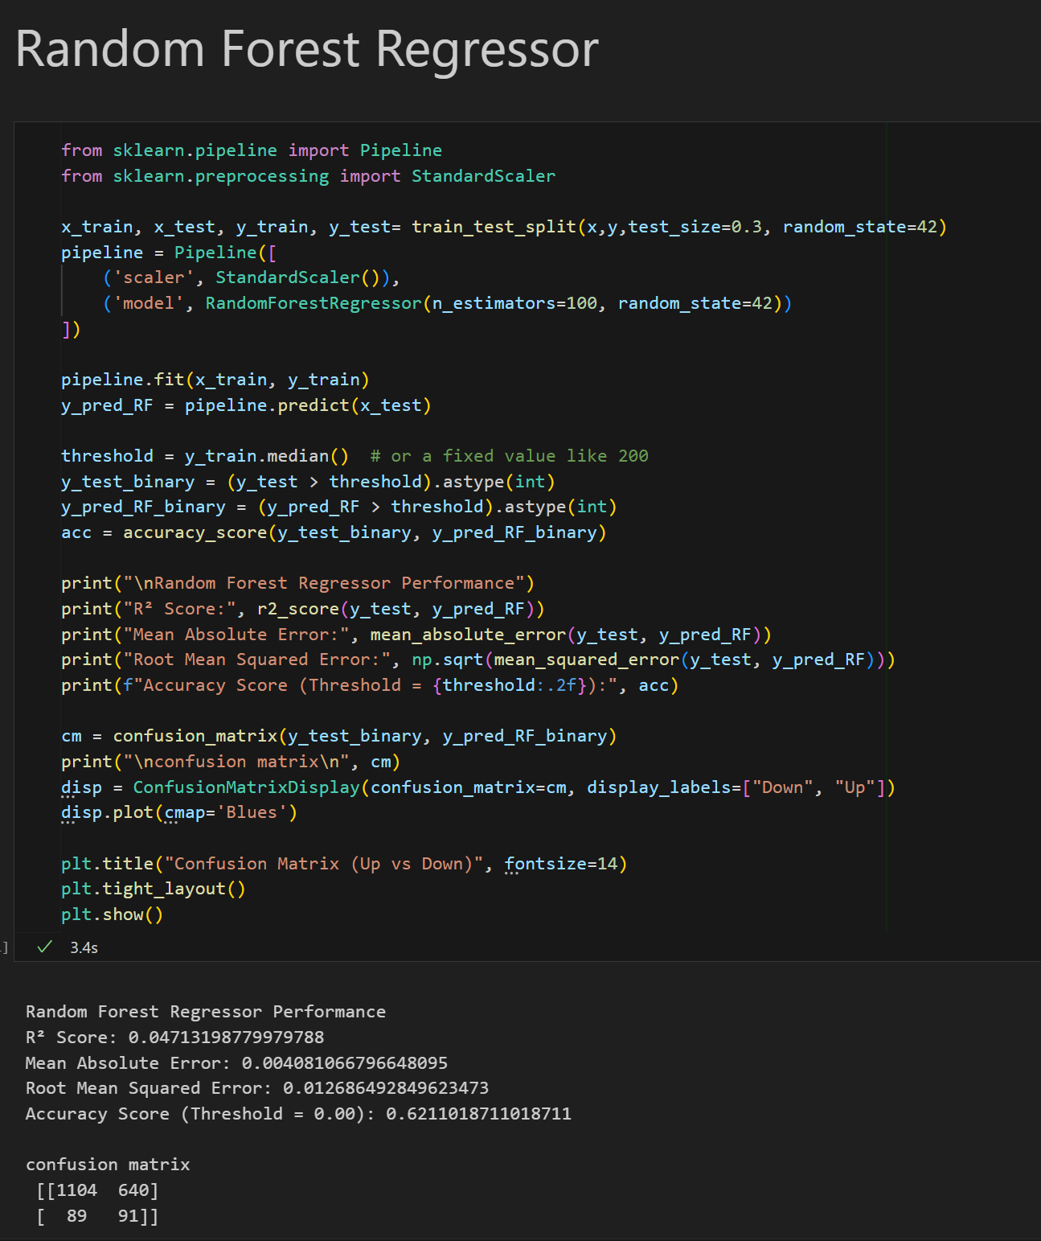
Random Forest Regressor Performance
Random Forest Regressor Performance
R² Score: 0.04713198779979788
Mean Absolute Error: 0.004081066796648095
Root Mean Squared Error: 0.012686492849623473
Accuracy Score (Threshold = 0.00): 0.6211018711018711

Slide 20
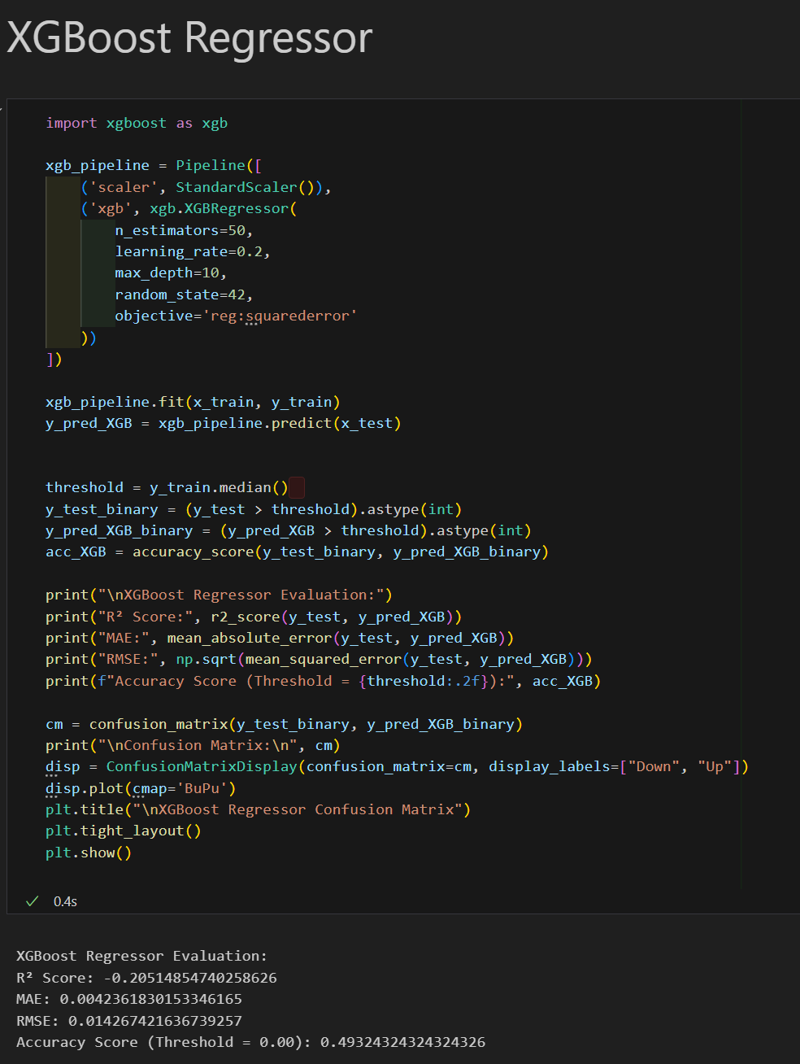
XGBoost Regressor Performance
XGBoost Regressor Performance
R² Score: -0.20514854740258626
MAE: 0.0042361830153346165
RMSE: 0.014267421636739257
Accuracy Score (Threshold = 0.00): 0.49324324324324326

Slide 21
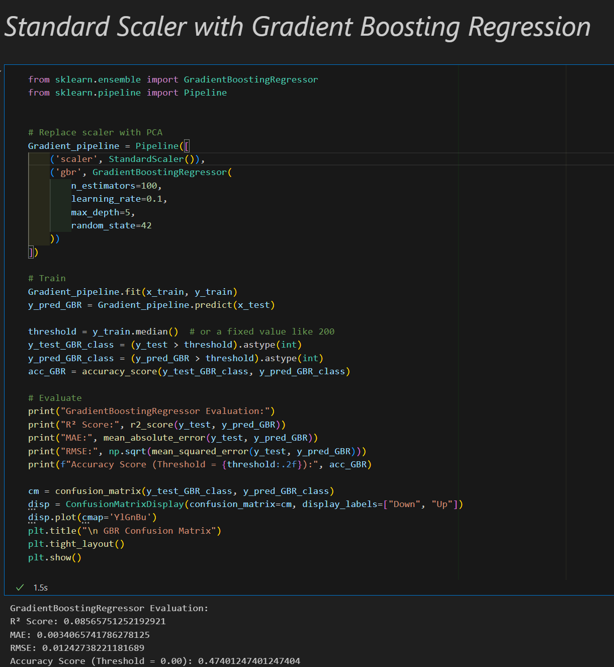
Gradient Regressor Performance
Gradient Boosting Regressor Evaluation:
R² Score: 0.08565751252192921
MAE: 0.0034065741786278125
RMSE: 0.01242738221181689
Accuracy Score (Threshold = 0.00): 0.47401247401247404

Slide 22
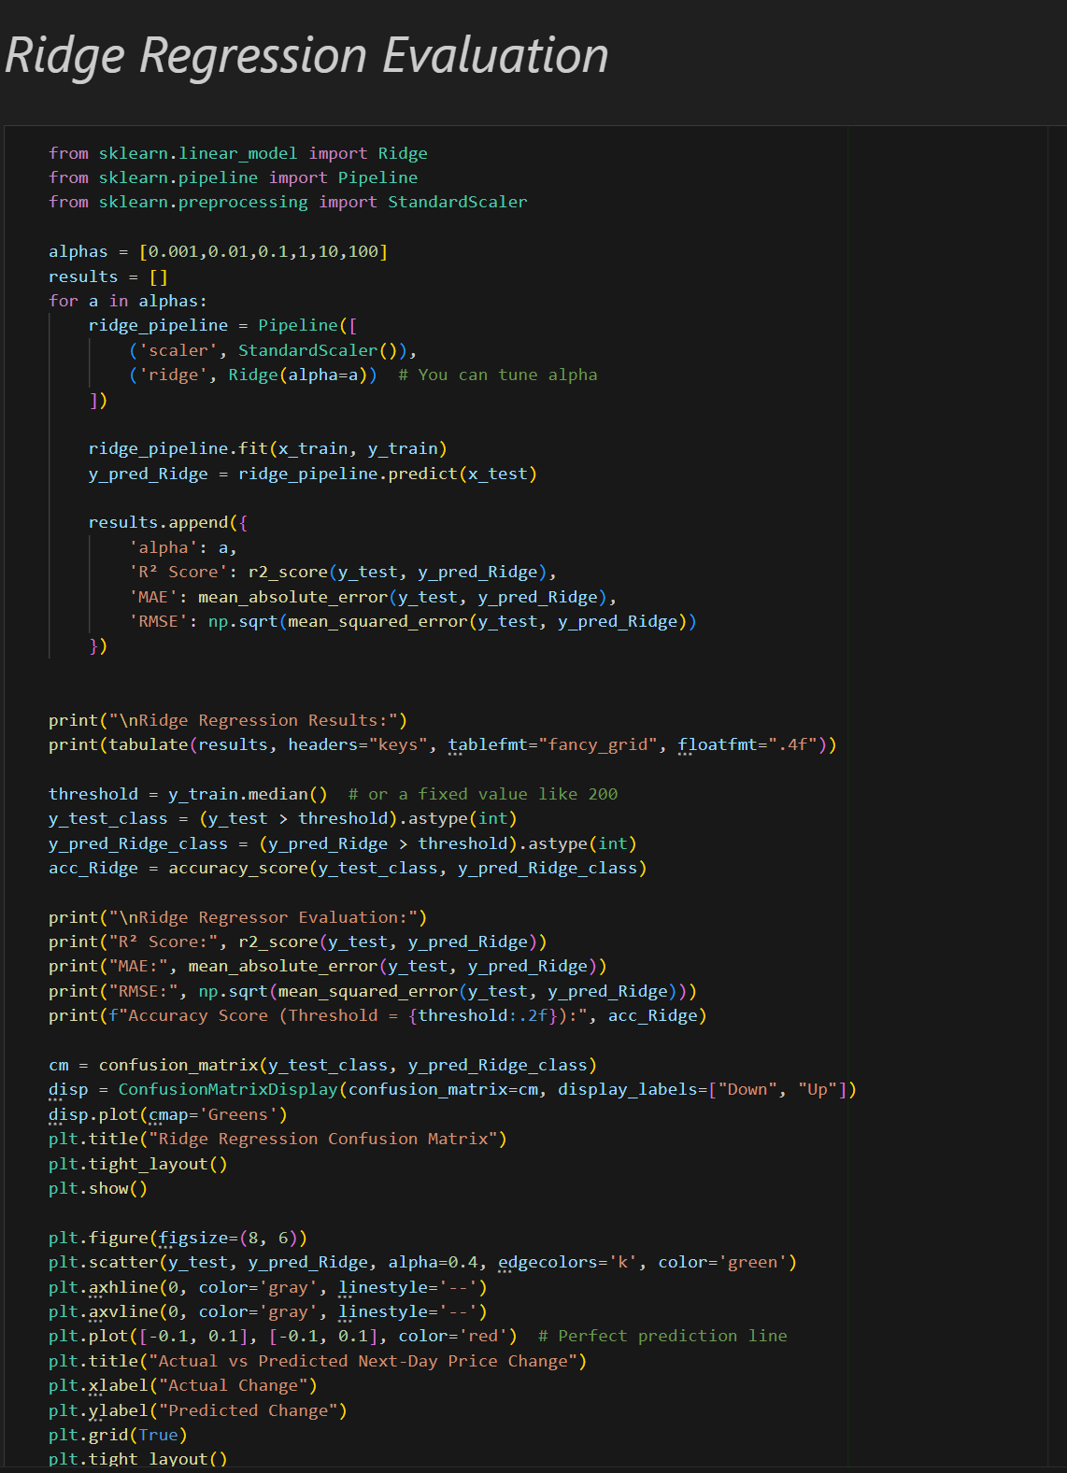
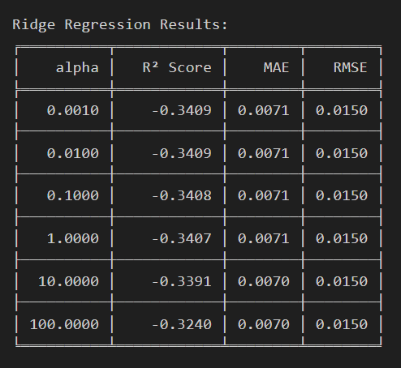
Ridge Regressor Performance
Ridge Regressor Evaluation:
R² Score: -0.3239896031306271
MAE: 0.006950907265212771
RMSE: 0.014954348331135696
Accuracy Score (Threshold = 0.00): 0.6081081081081081

Slide 23
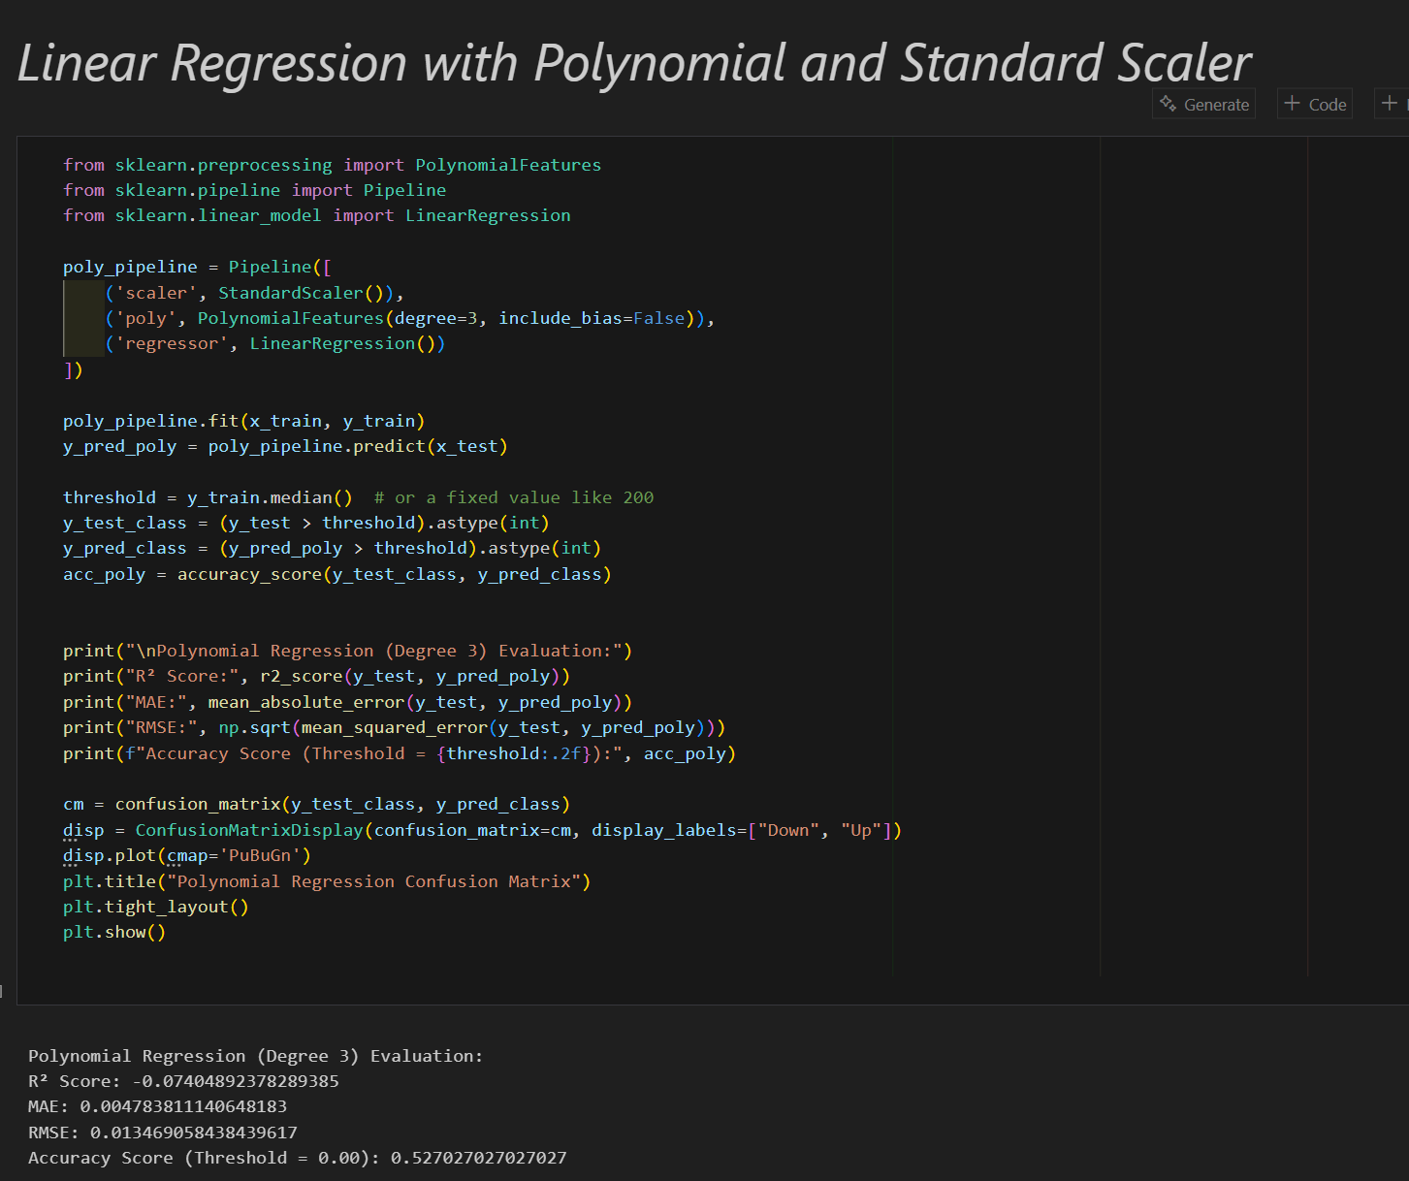
Linear Regression with Polynomial Performance
Polynomial Regression (Degree 3) Evaluation:
R² Score: -0.07404892378289385
MAE: 0.004783811140648183
RMSE: 0.013469058438439617
Accuracy Score (Threshold = 0.00): 0.527027027027027
Polynomial Regression (Degree 2) Evaluation:
R² Score: -0.14037931966722939
MAE: 0.005300619008974772
RMSE: 0.013878734619625913
Accuracy Score (Threshold = 0.00): 0.5213097713097713
Polynomial Regression (Degree 1) Evaluation:
R² Score: -0.3408617591345502
MAE: 0.007058513189986293
RMSE: 0.01504933145975856
Accuracy Score (Threshold = 0.00): 0.6086278586278586

Slide 24

Insight of Model Performances and Interactive Dashboard

Slide 25
Model Performances & Conclusion
Model | R² Score | RMSE | MAE | Accuracy
Random Forest | 0.047 | 0.0127 | 0.0041 | 0.621
Gradient Boosting | 0.086 | 0.0124 | 0.0034 | 0.474
XGBoost | -0.205 | 0.0143 | 0.0042 | 0.493
Ridge Regression | -0.324 | 0.0150 | 0.0071 | 0.608
Polynomial (Deg 1) | -0.341 | 0.0150 | 0.0071 | 0.609
Polynomial (Deg 2) | -0.140 | 0.0139 | 0.0053 | 0.521
Polynomial (Deg 3) | -0.074 | 0.0135 | 0.0048 | 0.527
Best Model Overall: Random Forest Regressor
Highest directional accuracy: 62.1%
Reasonable R²: Slightly positive, better than most others
Stable performance: Handles noise and non-linear patterns well
Not overfitting: Unlike high-degree polynomial or XGBoost.
Secondary Insight: Gradient Boosting
Gradient Boosting had slightly better R² and lower MAE but much lower accuracy (47%).
If our main goal is direction (up/down prediction), then Random Forest is clearly superior.
However, continuous value prediction (e.g., how much the price will change), then Gradient Boosting is a strong second.

Slide 26
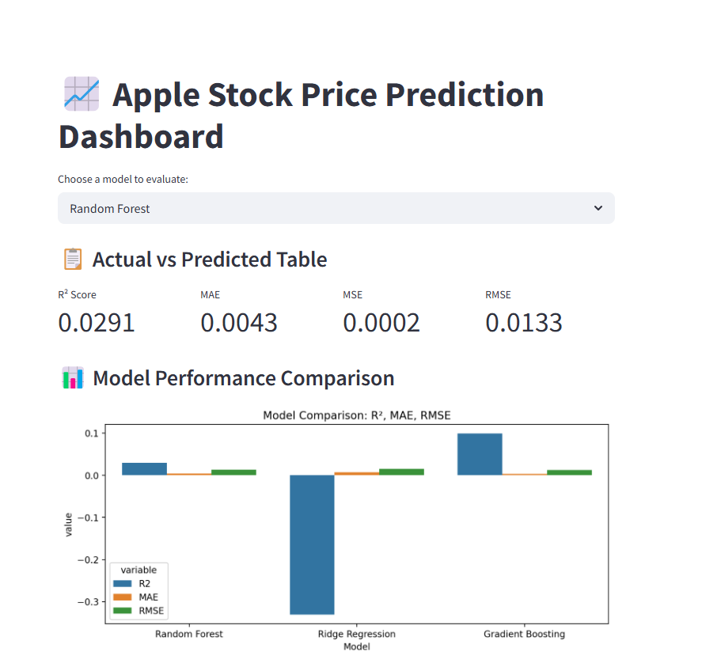
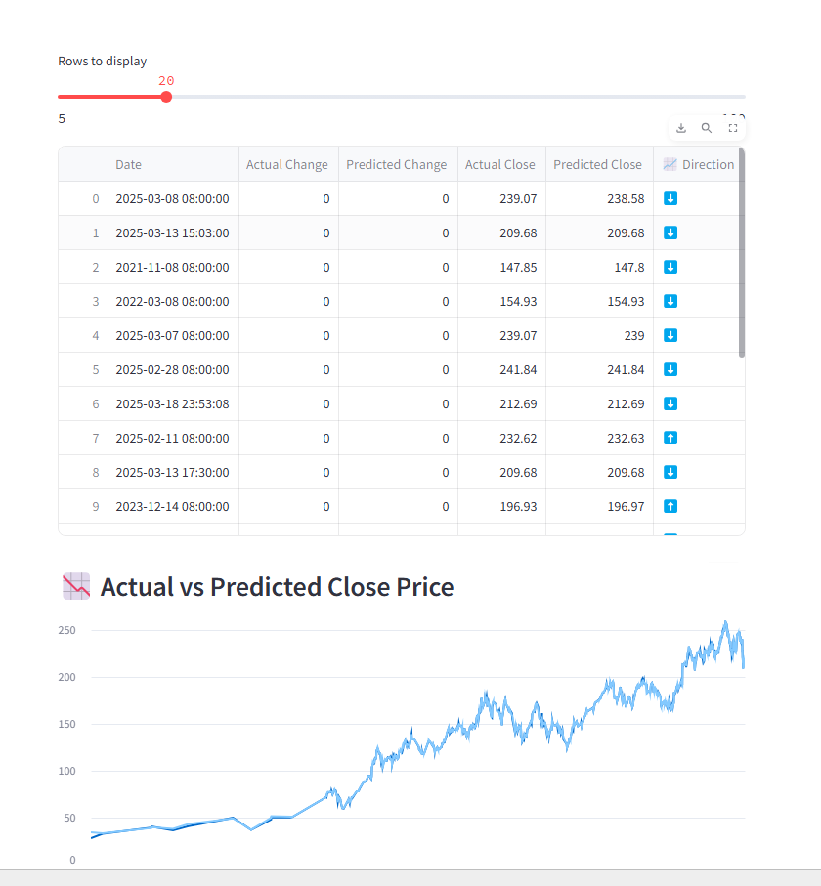
Dashboard
This dashboard presents a machine learning-based analysis of Apple Inc.'s stock movements using a combination of technical indicators and GPT-enriched sentiment features.
Users can interactively select between models—Random Forest, Ridge Regression, and Gradient Boosting—to compare predictive performance through R², MAE, RMSE, and classification accuracy.
The dashboard also includes visual tools like line charts, confusion matrices, and feature importance plots to interpret results and gain insights into the impact of news-driven sentiment on stock price behavior.
Dashboard Access Link-- >
https://csis-4260-specialtopicindataanalytics-git-rgmtpshqpazxqz8ofacx.streamlit.app/

Slide 27

References

Slide 28
Appendix A: Tools, Libraries & Models
Python Libraries Used
pandas, numpy, matplotlib, seaborn – data handling & visualization
scikit-learn (sklearn) – ML models & metrics
Random Forest Regressor, Gradient Boosting Regressor, Ridge, train_test_split, Standard Scaler, Pipeline, Polynomial Features, metrics, permutation_importance
xgboost – XGBoost Regressor
scipy.stats – Pearson correlation
tabulate – console formatting
tensorflow.keras (LSTM used but Dropped)

Slide 29
Appendix B: Files & Scripts Used
industry_analysis.py, top_3_companiesofsectors.py – Industry/Company Selection
3.Apple_5yr_historicdata.py – Historical Stock Retrieval
4.A_AppleNews_Queries_RSS.py, 4.B_AppleNews_Scrape_NewsAPI.py, 4.C_AppleNews_Scrape_Yfinance.py, 4.D_AppleNews_GoogleRSS.py – News Scraping
5.C_OpenAI_Google_Rss.py, 5.E_Generate_Summary.py – GPT Enrichment
5.A_Preprocessing.py, 6.C_Drop_in_Audit.py, 6.D_Correlation_Analysis.py – Cleaning, Feature Selection
6.B_Keywords_Evaluation.py, 5.B_Topic_Modeling_BERTopic.py – BERTopic & NLP
9.A_Merge_news_and_data.py – Feature Integration
10.apple_stock_ml.ipynb – All ML Models Evaluation
APPLE_Dashboard.py – Streamlit Visualization

Slide 30
Appendix C: Evaluation Metrics Used, References & Citation Sources
Data Sources
Yahoo Finance (yfinance) – Stock prices, historical OHLC
https://finance.yahoo.com/
Financial Modeling Prep (FMP API) – Sector & industry data
https://financialmodelingprep.com/
NewsAPI.org – Apple-related news
https://newsapi.org/docs
Google News RSS – Headline news for Apple
https://news.google.com/rss
Google Custom Search + BeautifulSoup – Used for scraping titles/snippets
https://programmablesearchengine.google.com/
Yahoo Finance News (web scraped)
https://finance.yahoo.com/news/
R² Score – Regression model fit
MAE (Mean Absolute Error) – Avg error magnitude
RMSE (Root Mean Squared Error) – Penalizes large errors
Directional Accuracy – Up/Down prediction accuracy from log-based price change

